Slide 1
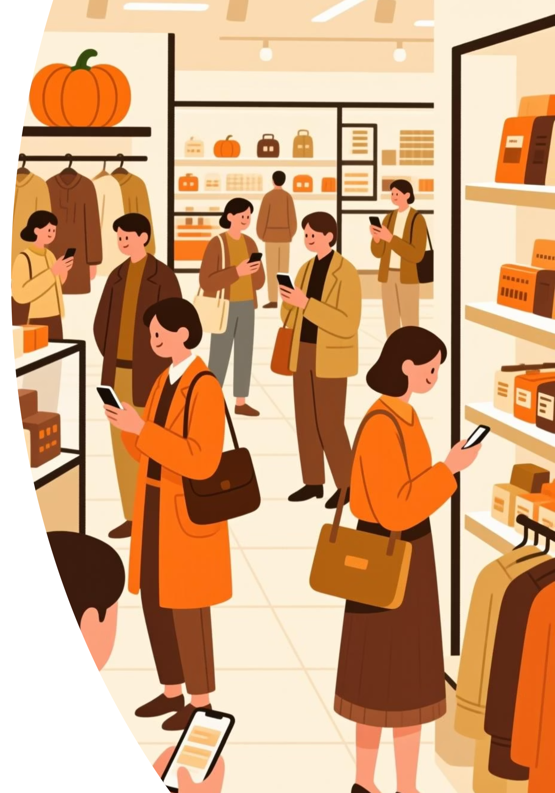
Customer Shopping Behavior Analysis
Understanding customer behavior is crucial for improving sales, satisfaction, and loyalty. We'll analyze purchasing patterns across demographics, products, and channels to optimize strategies.

Slide 2

The Business Challenge
Changing Patterns
Management observed shifts in purchasing across demographics, categories, and sales channels.
Key Drivers
Identify factors like discounts, reviews, seasons, and payment preferences influencing decisions and repeat purchases.
Our goal: Leverage consumer shopping data to identify trends, improve engagement, and optimize marketing and product strategies.

Slide 3




Project Overview & Deliverables
Data Preparation & Modeling
Data Analysis
Clean and transform raw data using Python.
Extract insights on segments, loyalty, and purchase drivers using SQL.
Visualization & Insights
Report & Presentation
Build an interactive Power BI dashboard for data-driven decisions.
Summarize findings and recommendations for stakeholders.
This project analyzes 3,900 purchases to uncover spending patterns, customer segments, and product preferences.

Slide 4

Dataset Summary
Key Statistics
Key Features
Rows: 3,900
Customer Demographics: Age, Gender, Location, Subscription Status
Columns: 18
Purchase Details: Item, Category, Amount (USD), Season, Size, Color
Missing Data: 37 values in "Review Rating"
Shopping Behavior: Discount, Promo Code, Previous Purchases, Frequency, Review Rating, Shipping Type

Slide 5
Exploratory Data Analysis (Python)
01
02
03
Data Loading & Exploration
Missing Data Handling
Column Standardization
Imported dataset with pandas; used df.info() and df.describe() for initial checks.
Imputed missing "Review Rating" values using the median rating per product category.
Renamed columns to snake_case for improved readability.
04
05
Feature Engineering
Database Integration
Created age_group and purchase_frequency_days columns.
Loaded cleaned data into MySQL for SQL analysis.

Slide 6
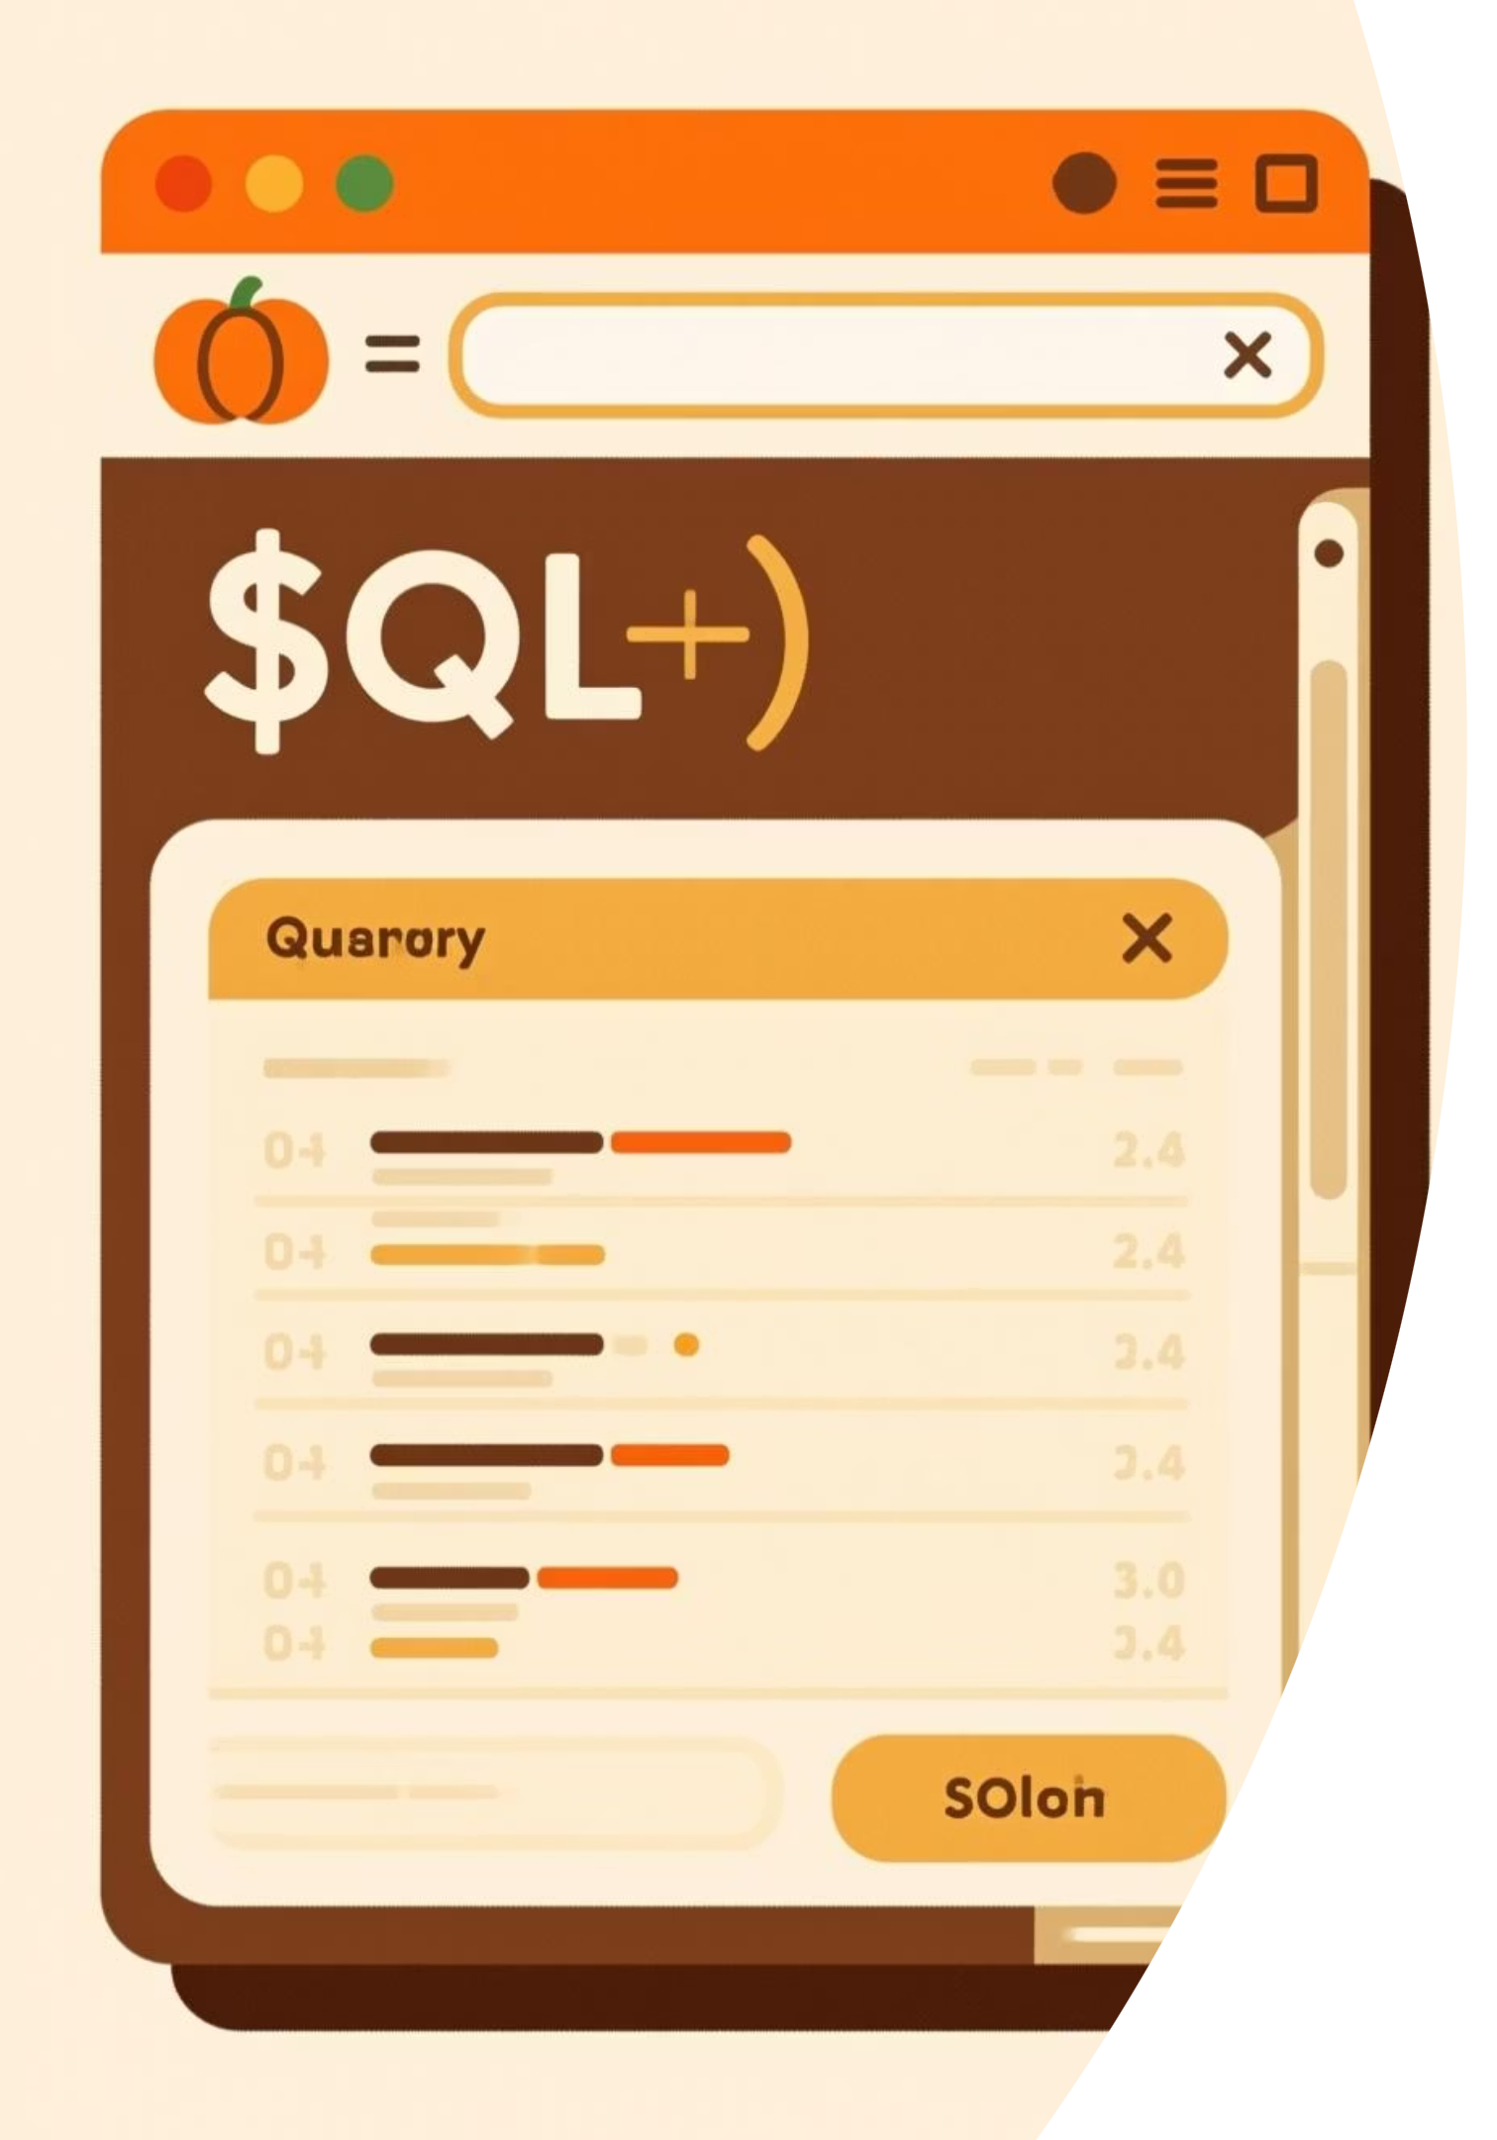
SQL Analysis: Key Business Insights
1
Revenue by Gender
Male: $157,890, Female: $75,191
2
Top 5 Products by Rating
Gloves (3.86), Sandals (3.84), Boots (3.82), Hat (3.80), Skirt (3.78)
3
Shipping Type Comparison
Standard: $58.46, Express: $60.48 (Avg. Purchase)
4
Discount-Dependent Products
Hat (50%), Sneakers (49.66%), Coat (49.07%), Sweater (48.17%), Pants (47.37%)

Slide 7
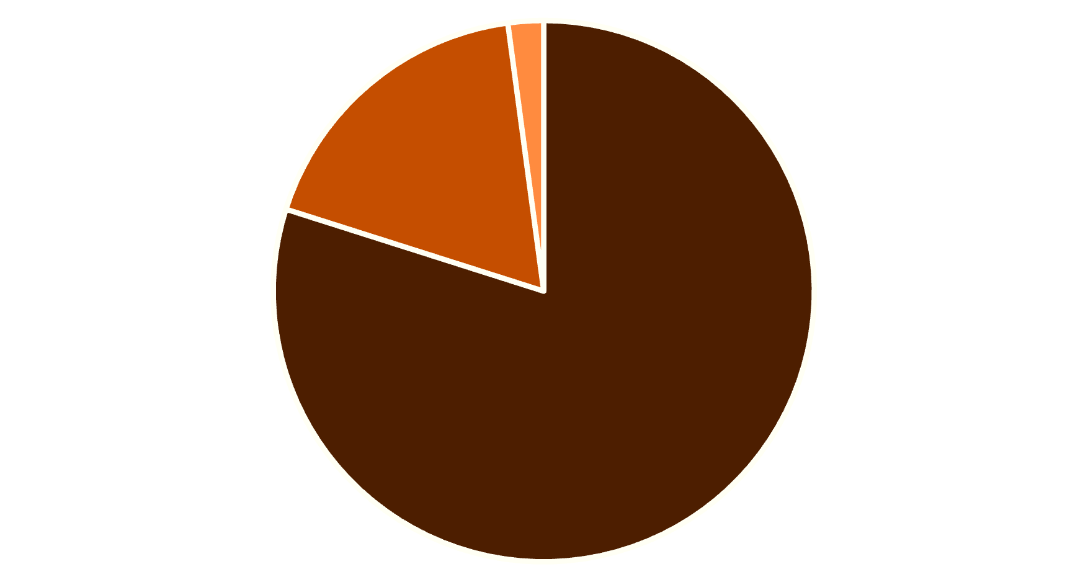
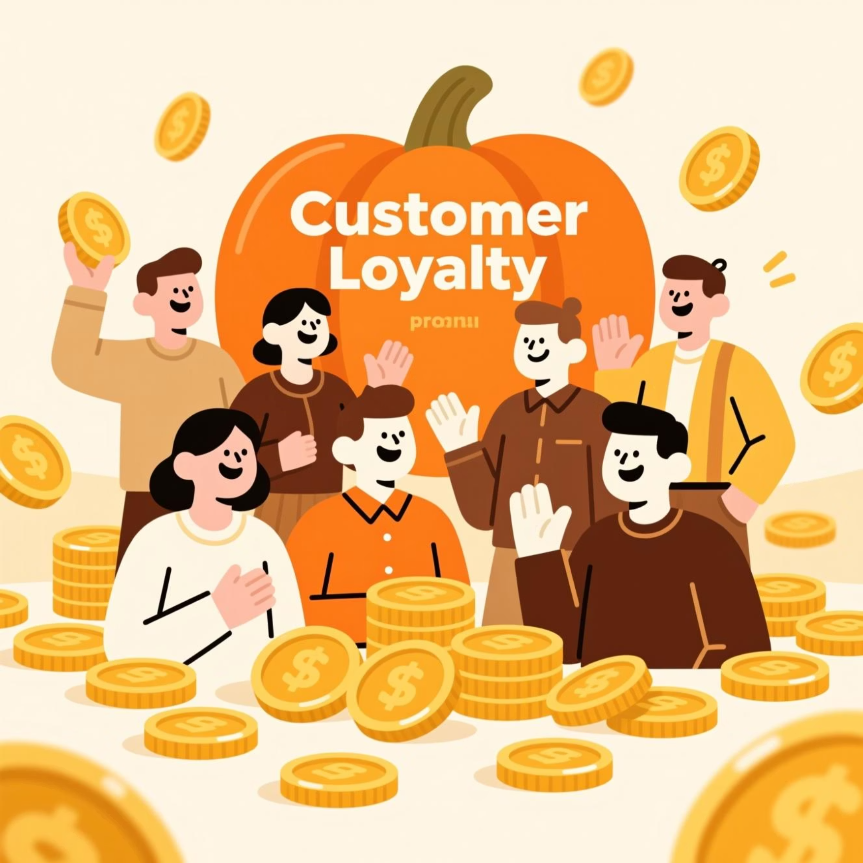
Customer Segmentation & Loyalty
Customer Segments
Subscribers vs. Non-Subscribers
Subscribers: 1,053 customers, Avg. Spend: $59.49, Total Revenue: $62,645
Non-Subscribers: 2,847 customers, Avg. Spend: $59.87, Total Revenue: $170,436
Repeat buyers (>5 purchases) are more likely to subscribe (958 Yes vs. 2518 No).
Loyal
Returning
New

Slide 8
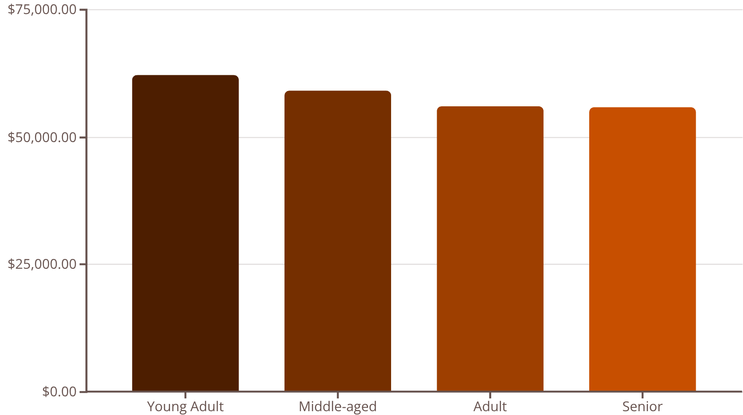
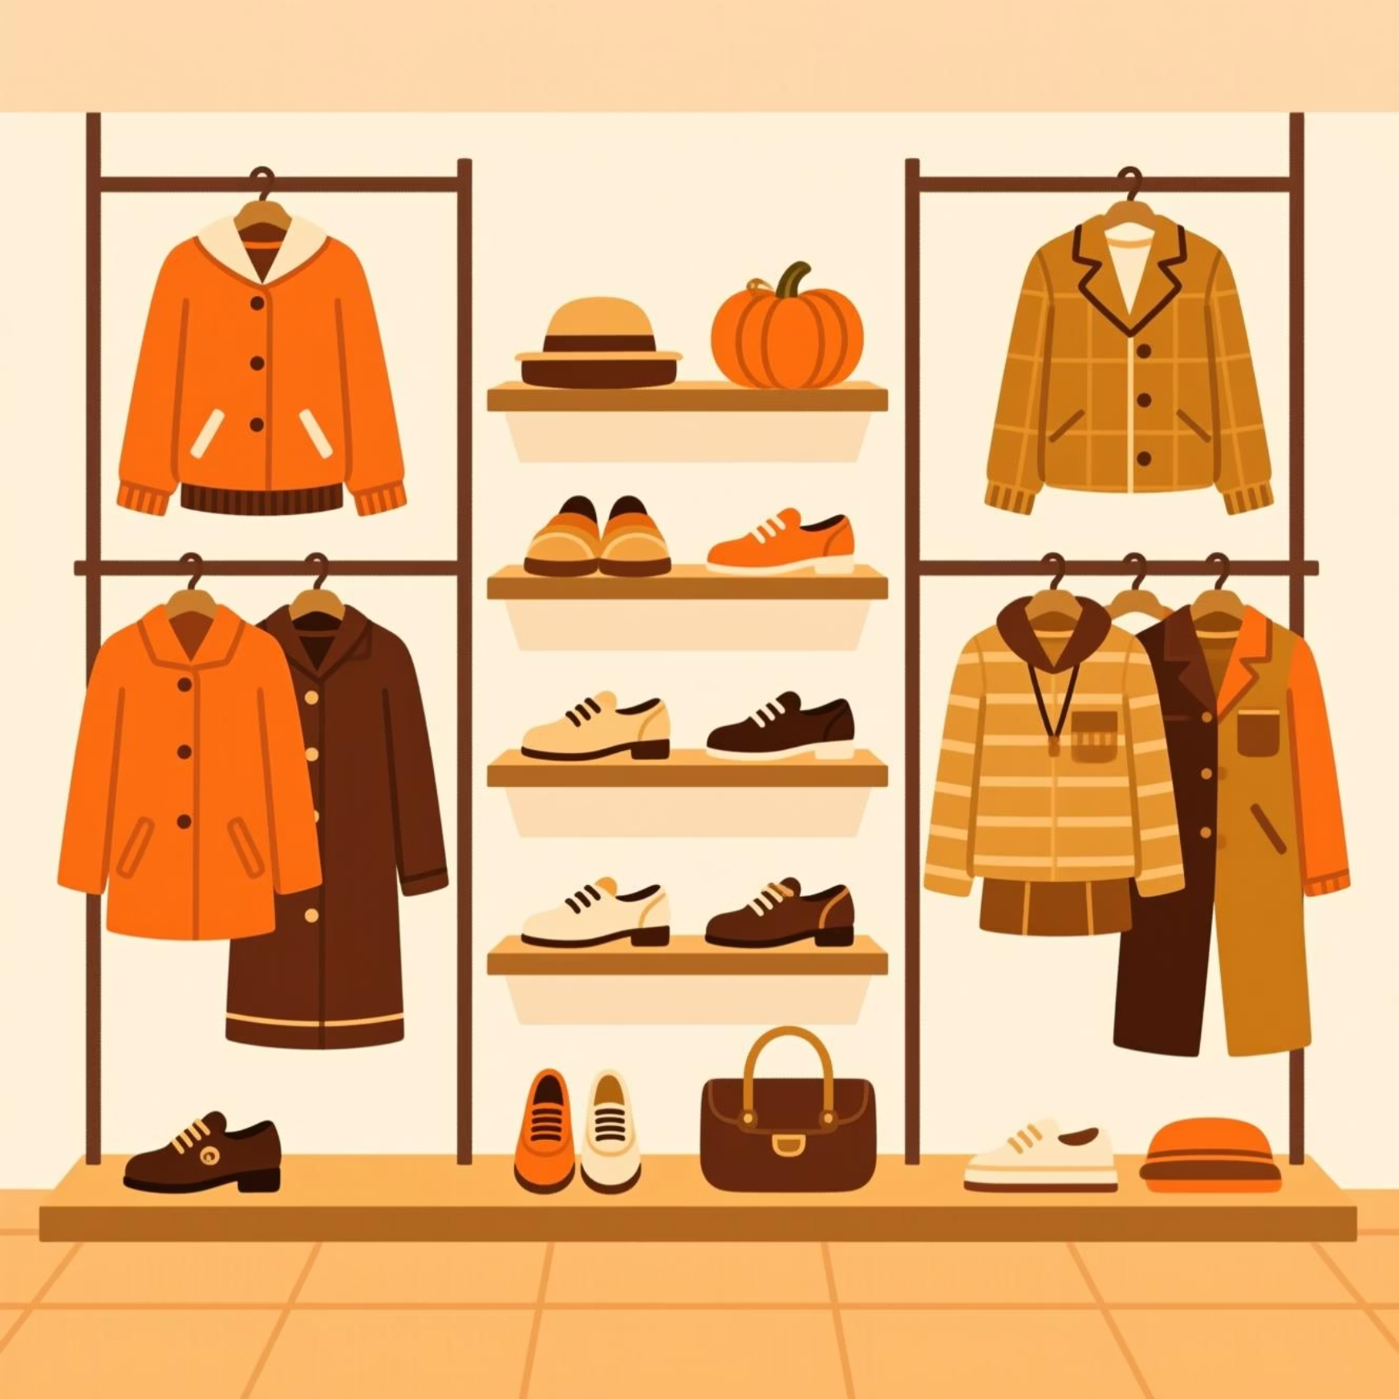
Product Performance & Age Group Revenue
Top Products per Category
Revenue by Age Group
Accessories: Jewelry, Sunglasses, Belt
Clothing: Blouse, Pants, Shirt
Footwear: Sandals, Shoes, Sneakers
Outerwear: Jacket, Coat

Slide 9
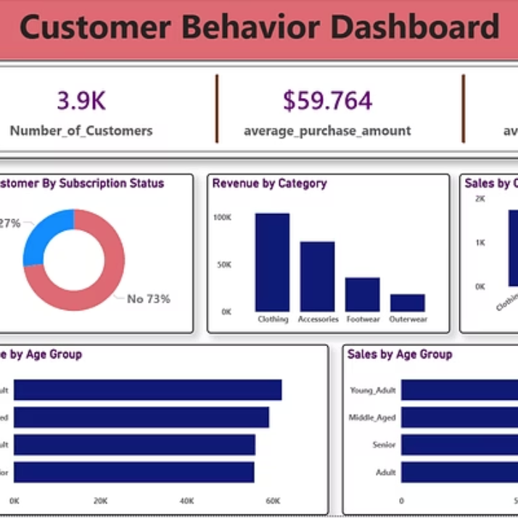

Power BI Dashboard: Visualizing Insights
An interactive dashboard provides key metrics and visualizations for data-driven decisions.
3.9K Customers
$59.76 Avg. Purchase
3.75 Avg. Review Rating

Slide 10
Actionable Recommendations
1
Boost Subscriptions
Promote exclusive benefits to increase subscriber base.
2
Customer Loyalty Programs
Reward repeat buyers to foster loyalty and move them into the "Loyal" segment.
3
Review Discount Policy
Balance sales boosts from discounts with margin control.
4
Product Positioning
Highlight top-rated and best-selling products in marketing campaigns.
5
Targeted Marketing
Focus efforts on high-revenue age groups and express-shipping users for maximum impact.

